Slide 1
Breaches and State Bars: Legal Ethics in Cybersecurity and Data Breaches
Seth M. Wolf
Associate General Counsel University Hospitals Health System
Scott Bennett
Coppersmith Brockelman, PLC

Slide 2
Why Lawyers Need to Care about Information Security & Data Breaches
aka “The Part Where We Tell You a Bunch of Horror Stories to Scare You Into Paying Attention”

Slide 3
Does my law firm really need to worry about a data breach?
About two-thirds of law firms have experienced some type of data breach, according to a 2017 LogicForce report
40%

Slide 4
Cautionary tale: DLA Piper

Slide 5
Cautionary tale: Cravath

Slide 6
Cautionary tale: NY attorneys

Slide 7
Cautionary tale: San Diego firm

Slide 8
When law and IT collide . . .

Slide 9
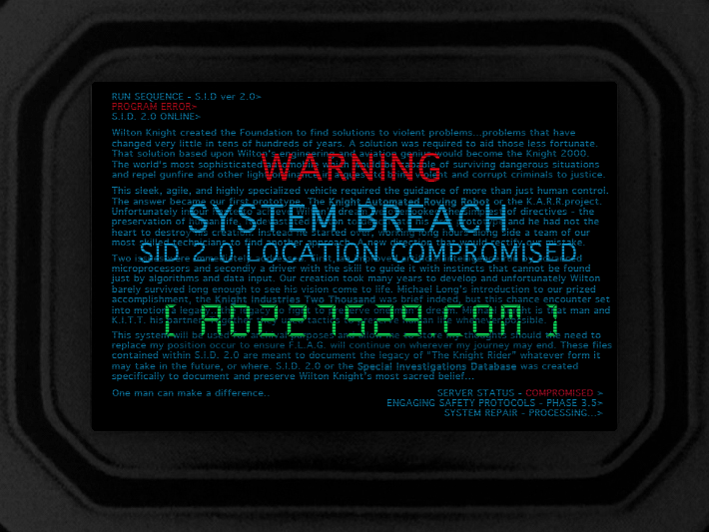
Breach Prevention & Preparation

Slide 10
ABA Model Rules
Will use ABA Model Rules as framework
49 states (not California) plus D.C. have ethics rules that follow format of Model Rules
39 states plus D.C. have adopted Model Rules’ comments for guidance
Important to check your state’s rules

Slide 11
Duty of tech competence
Model Rule 1.1: Competence requires necessary legal knowledge, skill, thoroughness, preparation
Comment 8: “To maintain the requisite knowledge and skill, a lawyer should keep abreast of changes in the law and its practice, including the benefits and risks associated with relevant technology . . .”

Slide 12
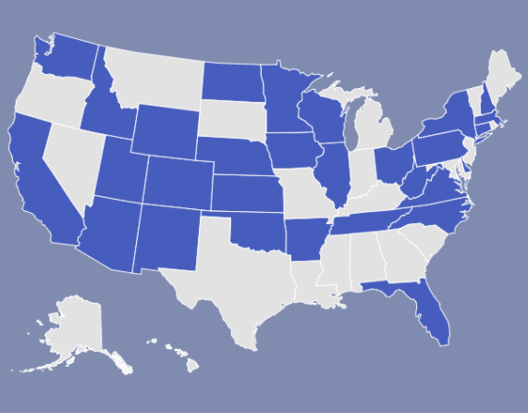
States that require tech competence
As of October 2017, more than half the states had adopted some duty of tech competence:

Slide 13
Three paths to competence
You know it already.
You don’t know it already, but you invest the time and effort to learn it.
You don’t know it, and either can’t or don’t want to learn it, so you bring in someone else who does know it.
The Bottom Line: Know Thyself

Slide 14
Duty to safeguard information
Model Rule 1.6(c): Must make “reasonable efforts” to prevent unauthorized disclosure of information relating to the representation of a client
Covers both stored information & communications [cmts 18 & 19]

Slide 15
What information are lawyers ethically required to safeguard?
Information “relating to the representation of a client” [Model Rule 1.6(c)]
Broader than privileged communications [cmt. 3]
But narrower than all information held by an attorney
-E.g., breach of law firm’s payroll records not an ethical violation

Slide 16
What does it mean to safeguard information?
Model Rule 1.6 requires reasonable efforts, not a guarantee of security
What is reasonable? Must consider:
Sensitivity of the information
Likelihood of disclosure
Cost of additional safeguards
Difficulty of implementing the safeguards, and
Extent to which the safeguards would adversely affect the lawyer’s ability to represent clients (e.g., by interfering with the use of key software)

Slide 17
Lawyers as Business Associates
A law firm working with PHI from a covered entity client is a business associate, and is directly liable for complying with the Security Rule
-Failure to comply with Security Rule = Failure to comply with the law
The Security Rule and the BAA the law firm signs may obligate the law firm to utilize greater security measures in relation to PHI than are required by ethical rules
Example: The Security Rule requires encryption of ePHI if reasonable and appropriate, and if encryption is not used the law firm must document why (45 CFR 164.312(a)(2)(iv); 164.306(d)(3)); this is broader than the ethical requirement

Slide 18
Lawyers as Business Associates
June 2016 – First enforcement of Security Rule directly against a business associate (Catholic Health Care Services of the Archdiocese of Philadelphia)
Stolen iPhone containing patient data
Business Associate paid $650,000 fine and agreed to corrective action plan

Slide 19
Lawyers as Business Associates
CAP required BA to:
Conduct annual risk assessments
Develop, distribute and update policies and procedures to all workforce members
Policies/procedures must address: encryption, password management, security incident response, mobile device controls, information system reviews, security reminders, log-in monitoring, data backup, disaster recovery, emergency operations, testing contingency plans, application and data criticality analysis, automatic log-off, audit controls and integrity controls

Slide 20
Safeguarding information: Best practices
Similar to what HIPAA Security Rule requires of CEs and BAs
Assess and manage risks
Implement safeguards
Train and supervise personnel
Enact policies and procedures
Use care in selecting vendors
Take corrective action
Update as necessary

Slide 21
Safeguarding information: Best practices
Assess and manage risks
People are probably your biggest risk factor
Consider risks to:
Confidentiality (accessible only to authorized people)
Integrity (not altered or destroyed)
Availability (accessible when needed)
Create plan to address gaps
Resources
ONC Security Risk Assessment Tool
Massachusetts Information Security Risk Assessment Guidelines

Slide 22
Are lawyers ethically required to conduct a security risk analysis?
ABA Formal Opinion 477R (May 15, 2017)
“[T]the reasonable efforts standard [of Rule 1.6]: . . . adopts a fact-specific approach to business security obligations that requires a ‘process’ to assess risks, identify and implement appropriate security measures responsive to those risks, verify that they are effectively implemented, and ensure that they are continually updated in response to new developments.”
Sounds very similar to the risk analysis and management required by the HIPAA Security Rule. [45 CFR 164.308(a)(1)(ii); 164.306(e)]

Slide 23
Safeguarding information: Best practices
Implement safeguards
Administrative (people & policies)
Physical (access to facilities & devices; use of electronic media)
Technical (controls for access, audit, integrity; transmission security)

Slide 24
Safeguarding information: Best practices
Password management (strong, unique, changed often, not stored near devices)
Encrypt devices and data (safe harbor under HIPAA and many state laws)
Limit employee access (only information needed to do job, revisit access when change roles or leave the organization)
Collect and keep only information you need
Electronic logging (record exfiltration of data, have enough capacity to avoid gaps)
Use antivirus and anti-malware software, and keep it up to date
Install patches and updates on all software
Consider using multi-factor authentication for firm systems

Slide 25
Client Resources?
If you advise a larger healthcare provider, have you asked:
Whether the client has IT security staff that could informally advise you on security?
Whether the client operates a secure collaboration platform (e.g., SharePoint, Box), secure email platform, and/or secure texting platform in which your firm could participate for that client’s matters?
Whether the client has a list of approved mobile devices (e.g., encrypted USB keys) that may be used to move or store ePHI?

Slide 26
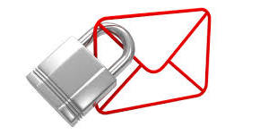
Encrypting email
The Rule: Lawyers “must take reasonable precautions to prevent [communications] from coming into the hands of unintended recipients.”
Extra security measures might be required in “special circumstances.” [Model Rule 1.6, cmt. 19]
2017 ABA Opinion: Routine emails do not need encryption. But lawyers must determine, on a case-by-cases basis, whether encryption is reasonable for a particular situation. [Formal Opinion 477R]

Slide 27
Safeguarding information: Best practices
Train and supervise personnel
Supervising lawyers must work to ensure that supervised lawyers and staff comply with ethical rules. [Model Rules 5.1(b)&(c), 5.3(b)&(c)]
Train at start of employment & annually
Provide ongoing education
Document evidence of training and education

Slide 28
Safeguarding information: Best practices
Enact policies and procedures
Managing attorneys have duty to implement measures to try to ensure that lawyers and staff comply with ethical rules. [Model Rules 5.1(a), 5.3(a)]
Make sure you include an incident response plan

Slide 29
People are probably your biggest risk

Slide 30
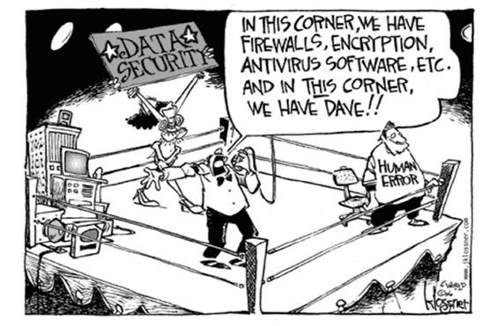
People are probably your biggest risk

Slide 31
Safeguarding information: Best practices
Use care in selecting vendors
Must make “reasonable efforts” to ensure that vendors keep information confidential [Model Rule 5.3, cmt 3]
What is reasonable? Depends on:
Education, experience, and reputation of vendor
Nature of the services involved
Terms of arrangement with vendor (and client)
Applicable legal and ethical requirements
Resource: ABA Vendor Contracting Project: Cybersecurity Checklist (Oct. 17, 2016)

Slide 32
Safeguarding information: Best practices
Take corrective action
Stop the breach
Identify the root cause and fix it
Address any systemic issues
Retrain and/or discipline personnel

Slide 33
Safeguarding information: Best practices
7. Update as necessary
“[T]echnology advances may make certain protective measures obsolete over time. . . . As technology advances occur, lawyers should periodically review security measures in place to ensure that they still reasonably protect the security and confidentiality of the clients’ documents and information.”
[Ariz. Ethics Opinion 09-04 (2009)]

Slide 34
Breach Response

Slide 35
Privilege and work product: Role of in-house counsel
Issue with in-house counsel who have nonlegal roles, or perform business functions
One tricky area: Factual investigations
Critical for in-house counsel to stay in their lane
Separate communications for legal and nonlegal issues
Expressly say which communications are which (e.g., “I write in response to your request for legal advice . . .”)
One factor that often leads companies to retain outside counsel for major incidents or breaches

Slide 36
Privilege and work product: Forensic consultants
Courts have recognized privilege when third parties are the functional equivalent of interpreters
Forensic consultants should be retained by legal counsel
The retention letter should expressly say for the purpose of facilitating legal advice
Producing the consultant’s report to the OCR or another government agency likely waives the privilege

Slide 37
Clarifying the identity of the client
Lawyer for organization represents the organization [Model Rule 1.13(a)]
Lawyer must explain identity of the client when there is a conflict between interests of the organization, and interests of “directors, officers, employees, members, shareholders or other constitutents” [Model Rule 1.13(f)]
Must make sure nonclient understands you do not represent; might want own representation; communications with you might not be privileged [Comment 10]

Slide 38
Breach situations where lawyer might need to clarify identity of client
Academic medical centers
Health information exchanges
Different entities that share an electronic medical record
Interviewing employees who might have some personal responsibility for the breach

Slide 39
Communicating with cyber insurers & insurance defense attorneys
Disclosure of info relating to representation allowed if client gives informed consent, permitted by ethical rules, or “the disclosure is impliedly authorized in order to carry out the representation” [Model Rule 1.6(a)]
Example of implied authorization: “a lawyer may be impliedly authorized to admit a fact that cannot properly be disputed or to make a disclosure that facilitates a satisfactory conclusion to a matter. ” [Comment 5]
Potential conflict between ethical duty of confidentiality, and contractual duty to cooperate with cyber insurer

Slide 40
Thank you
Scott Bennett
Coppersmith Brockelman PLC
602.381.5476
sbennett@cblawyers.com
Seth M. Wolf Associate General Counsel University Hospitals Health System (216) 767-8222 Seth.Wolf@UHhospitals.org

