Slide 1
The Opioid Epidemic: Combatting Substance Abuse through Regulating Health Care
Melissa A. Soliz, Esq., Coppersmith Brockelman PLC
msoliz@cblawyers.com
Bio: http://www.cblawyers.com/melissa-soliz/
February 20, 2018

Slide 2
Agenda
Introduction: the opioid epidemic at the state and national level
Licensing laws and regulations
Opioid prescribing and treatment laws and regulations
Privacy laws and regulations

Slide 3
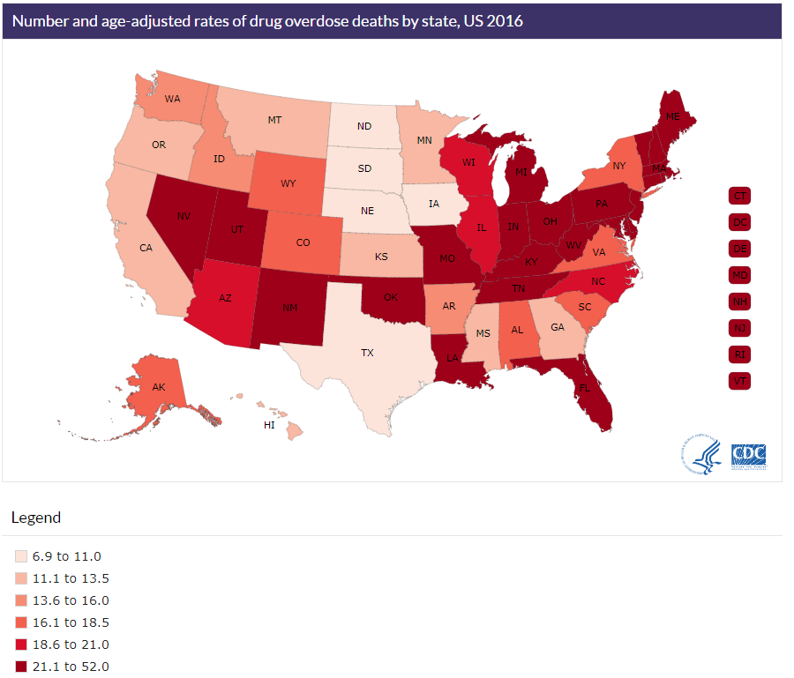
The Opioid Epidemic Nationally
CDC, https://www.cdc.gov/drugoverdose/data/analysis.html

Slide 4
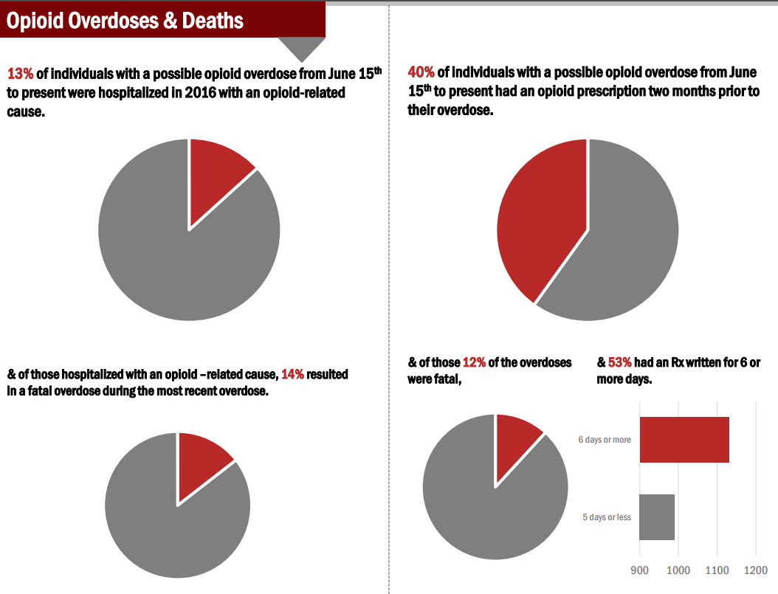
The Opioid Epidemic at Home
ADHS, http://www.azdhs.gov/documents/prevention/womens-childrens-health/injury-prevention/opioid-prevention/opioid-report.pdf (June 15-Feb. 15, 2018)

Slide 5
Arizona Leads the Way
Governor Ducey declares a State of Emergency due to the opioid overdose epidemic (Jan. 5, 2017).
Enhanced Surveillance Advisory (June 13 - Oct. 9, 2017). Authority: Executive Order 2017-04; Executive Order 2017-05; A.R.S. § 36-782 et seq.
ADHS issues emergency rules for opioid prescribing/treatment & reporting in July and September, 2017.
ADHS introduces proposed regulations for opioid prescribing & treatment, http://apps.azsos.gov/public_services/register/2017/46/04_proposed.pdf (MORE ON THIS AHEAD!)
ADHS publishes voluntary Arizona Opioid Prescribing Guidelines, http://www.azdhs.gov/documents/audiences/clinicians/clinical-guidelines-recommendations/prescribing-guidelines/draft-opioid-prescribing-guidelines.pdf
Governor Ducey signs the Opioid Epidemic Act of 2018 (Senate Bill 1001) on Jan. 26, 2018, https://www.azleg.gov/legtext/53leg/1S/laws/0001.htm (MORE ON THIS AHEAD!)
Summary of other state’s responses: http://www.azdhs.gov/documents/prevention/womens-childrens-health/injury-prevention/opioid-prevention/50-state-review-printer-friendly.pdf

Slide 6
The National Response
President Trump declared the opioid epidemic a “Public Health Emergency” on October 26, 2017.
The U.S. Department of Health and Human Services releases a 5-point strategy: (1) improving access; (2) promoting use of over-dose reversing drugs; (3) public health surveillance to better understand the epidemic; (4) support for research; and (5) better practices for pain management. https://www.hhs.gov/about/leadership/secretary/speeches/2017-speeches/secretary-price-announces-hhs-strategy-for-fighting-opioid-crisis/index.html
Budget Negotiations
President’s budget: $13 billion in funding ($3 billion in 2018; $10 billion in 2019) for treatment, recovery, mental health and prevention programs
Congressional bi-partisan budget: $6 billion in funding

Slide 7
Licensing Laws and Regulations at a Glance
Federal and State Requirements

Slide 8
The Federal Controlled Substances Act 21 U.S.C. §§ 801-890 & 21 C.F.R. Parts 1300-1316
Opioid analgesics are primarily Schedule II substances. Examples: morphine, codeine, opium, hydromorphone (Dilaudid®), methadone (Dolophine®), meperidine (Demerol®), oxycodone (OxyContin®), and fentanyl (Sublimaze® or Duragesic®).
DEA Registration: practitioners must be registered (or exempt by regulation, such as Public Health Service, federal prison, military).
Security & Recordkeeping Requirements
Prescription Requirements
Opioid Addiction Treatment Programs (e.g., methadone for maintenance and detox)
Separate registration required.
Approval and registration with SAMSHA’s Center for Substance Abuse Treatment (CSAT) Office is required.
Must request a waiver for use of buprenorphine drug products (8 hours training required).
Resources: DEA, Practitioner’s Manual, https://www.deadiversion.usdoj.gov/pubs/manuals/pract/pract_manual012508.pdf

Slide 9
Arizona’s Licensing Requirements
Arizona’s Uniform Controlled Substances Act, A.R.S. §§ 36-2501 – 36-2552
Requires DEA registration for dispensing and prescribing controlled substances (with limited exceptions).
Must follow the federal security and record keeping requirements.
Prescription orders for Schedule II drugs (other than hospital inpatient) must include specific information, and beginning on January 1, 2019, practitioners in Maricopa County and other large counties may only prescribe with an electronic prescription order. Applies to practitioners in smaller counties starting on July 1, 2019. A.R.S. § 36-2525.
Unprofessional Conduct (the Opioid Epidemic Act of 2018)
Unprofessional conduct to dispense opioids on site (except for opioids prescribed as part of medically assisted treatment for a substance use disorder).
Goal: ending pill mills

Slide 10
Opioid Prescribing and Treatment Laws and Regulations
The Opioid Prescribing Guidelines, Controlled Substances Prescription Monitoring Program, Emergency Regulations, the Opioid Epidemic Act and Proposed Regulations

Slide 11
Shifting Landscape: Current Law and Guidance
Controlled Substance Prescription Monitoring Program (CSPMP), A.R.S. §§ 36-2601– 2610.
Registration: practitioners with a DEA registration must also have a current CSPMP registration
Ending Doctor Shopping: practitioners must access and update the database before prescribing controlled substances and must check quarterly.
Emergency ADHS opioid prescribing and treatment regulations (expired!)
Emergency opioid reporting regulations, http://apps.azsos.gov/public_services/register/2017/41/15_emergency.pdf
Arizona’s Opioid Prescribing Guidelines (voluntary), http://azdhs.gov/documents/audiences/clinicians/clinical-guidelines-recommendations/prescribing-guidelines/az-opioid-prescribing-guidelines.pdf
Key feature: Pain Agreements, http://azdhs.gov/documents/audiences/clinicians/clinical-guidelines-recommendations/sample-patient-agreement-form.pdf
2017 Draft Hospital Discharge Planning Guidelines (voluntary), http://azdhs.gov/documents/audiences/clinicians/clinical-guidelines-recommendations/prescribing-guidelines/hospital-discharge-opioids.pdf
Arizona Guidelines for Emergency Department Controlled Substance Prescribing (voluntary), http://azdhs.gov/documents/prevention/womens-childrens-health/injury-prevention/prescription-drugs/az-guidelines-emergency-dept-controlled-substances.pdf (one sheet); http://azdhs.gov/documents/audiences/clinicians/clinical-guidelines-recommendations/prescribing-guidelines/az-er-dept-prescribing-guidelines.pdf (full report)

Slide 12
The Opioid Epidemic Act (SB 1001): Key Features
Eliminating Pill Mills & Doctor Shopping
Prescriber Education
Electronic Prescriptions
Over Prescribing
Dosage Limits
5-Day Limits on First Fills; 14-Day following Surgery
Prior Authorization Timeframes
Opioid Packaging
Protecting Individuals with Chronic Pain
Good Samaritan Law
Holding Manufactures Accountable
Increasing Oversight and Accountability
Treatment for Substance Use Disorders (SUD)
Source: SB 1001, https://www.azleg.gov/legtext/53leg/1S/laws/0001.htm (codified in Titles 32 and 36 of A.R.S.); the Governor’s Opioid Action Plan, http://azdhs.gov/prevention/womens-childrens-health/injury-prevention/opioid-prevention/opioids/index.php#action-plan

Slide 13
Proposed Opioid Prescribing and Treatment Regulations (1/2) Chapter 10, Title 9 of the Arizona Administrative Code
Status: notice of proposed rule making in November 2017 (waiting on final rule), http://apps.azsos.gov/public_services/register/2017/46/04_proposed.pdf
Normal Rulemaking Process: informal drafts; formal notice; 30 day comment period; oral proceeding (if requested); final rule submitted within 120 days after rule making record is closed; final rule effective 60 days after filed
Arizona’s Administrative Procedure Act, A.R.S. §§ 41-1001 through 1093.03
Key Features:
Applies to Health Care Institutions
Policies and procedures for prescribing, ordering, or administering opioids as part of treatment
Quality Management
Reporting of suspected opioid overdose deaths

Slide 14
Proposed Opioid Prescribing and Treatment Regulations (1/2) Chapter 10, Title 9 of the Arizona Administrative Code
Quality Management
Review of opioid-related adverse reactions / negative outcomes
Monitoring adherence to policies
Reporting Requirements
Suspected opioid overdoses related to an opioid prescribed or ordered as part of treatment (1 business day)
Prescribing, Ordering, & Administering Opioids
Policies/procedures must be consistent with the Arizona Opioid Prescribing Guidelines or other national guidelines
CSPMP review and reporting
Physical Examination
Substance Use Risk Assessment
Informed Consent: risks/benefits; alternatives
Patient Monitoring / Discharge Planning
Documentation in the Medical Record
Self Administration Protocols
Exceptions:
Ordering for emergencies (must be documented in the MR)
End-of-life (<6m) conditions or cancer
Changing type or dosage of opioid previously prescribed/ordered
Ordering for inpatient/residential treatment (no more than 3 days)
Ordering for surgery or invasive procedures

Slide 15
Privacy Laws and Regulations
HIPAA and 42 C.F.R. Part 2

Slide 16
Health Insurance Portability and Accountability Act (HIPAA)
HIPAA places very few restrictions on the sharing of health information to monitor the opioid epidemic and to treat patients struggling with addiction.
TPO: Allows sharing of Protected Health Information (PHI) among health care providers, plans and their business associates for Treatment, Payment and certain Health Care Operations activities. 45 C.F.R. § 164.506.
EXCEPTION! Psychotherapy Notes: Patient authorization is required. 45 C.F.R. § 164.508(a)(2).
“Psychotherapy notes means notes recorded (in any medium) by a health care provider who is a mental health professional documenting or analyzing the contents of conversation during a private counseling session or a group, joint, or family counseling session and that are separated from the rest of the individual's medical record. Psychotherapy notes excludes medication prescription and monitoring, counseling session start and stop times, the modalities and frequencies of treatment furnished, results of clinical tests, and any summary of the following items: Diagnosis, functional status, the treatment plan, symptoms, prognosis, and progress to date.” 45 C.F.R. § 164.501.
Public Health Reporting: Allows sharing of PHI with public health authorities authorized by law to receive the PHI for the public health reporting, surveillance, investigations and interventions. 45 C.F.R. § 164.512(b).
As Required by Law: Allows sharing of PHI to the extent required by law. 45 C.F.R. § 164.512(a)(1).

Slide 17
Confidentiality of Substance Use Disorder Patient Records (1/3)
42 U.S.C. § 290dd-2; 42 C.F.R. Part 2
42 C.F.R. Part 2 creates barriers to the sharing of health information to monitor the opioid epidemic and to treat patients struggling with addiction.
Purpose: “The laws and regulations governing the confidentiality of substance use disorder records were written out of great concern about the potential use of substance use disorder information against individuals, causing individuals with substance use disorders not to seek needed treatment. The disclosure of records of individuals with substance use disorders has the potential to lead to a host of negative consequences, including: Loss of employment, loss of housing, loss of child custody, discrimination by medical professionals and insurers, arrest, prosecution, and incarceration. The purpose of the regulations at title 42 of the Code of Federal Regulations (CFR) part 2 (42 CFR part 2) is to ensure that a patient receiving treatment for a substance use disorder in a part 2 program is not made more vulnerable by reason of the availability of their patient record than an individual with a substance use disorder who does not seek treatment. “ 82 Fed. Reg. 6052, at 6053 (Feb. 17, 2017).
Applicability: applies to Part 2 Information held by Part 2 Programs and “other lawful holders” of Part 2 Information
Criminal Penalties for Violations

Slide 18
Confidentiality of Substance Use Disorder Patient Records (2/3)
Part 2 Information: (1) PHI that identifies a person as a substance abuser; AND (2) Is obtained by a Part 2 Program.
Part 2 Program
An individual or entity (including a unit within a general medical facility) who holds itself out as providing substance use disorder (SUD) diagnosis, treatment, or referral for treatment, or medical personnel in a general medical facility whose primary function is to provide these services and are identified as such providers; and
Is federally assisted (e.g., is contracted with the federal government, licensed by the federal government to provide SUD treatment, receives any federal funds such as Medicaid/Medicare, or is a 501(c)(3) non-profit).
Other Lawful Holders
Third Party Payors (e.g., health plans)
Entities that have direct administrative control over the Part 2 Program (e.g., a general medical facility in which a SUD treatment unit is located)
Consent recipients who receive the Part 2 information with the prohibition on re-disclosure notice
Contractors of Part 2 Programs (called Qualified Service Organizations or QSO) and contractors of other lawful holders that are consent recipients
Researchers and auditors who receive Part 2 information without patient consent

Slide 19
Confidentiality of Substance Use Disorder Patient Records (3/3)
Rule of Thumb: Patient consent is required for the disclosure, unless an exception applies.
Exceptions:
Medical emergency
Research, audit and evaluations
Court order with subpoena.
Direct administrative controls
Qualified service organizations (QSOs), contractors of other lawful holders that are consent recipients, and their subcontractors.
Child abuse/neglect.
Cause of death.
Crimes on Part 2 Program premises, against Part 2 Program personnel, or the threat thereof
Patient Consent Requirements: complex and difficult to implement

